Slide 2
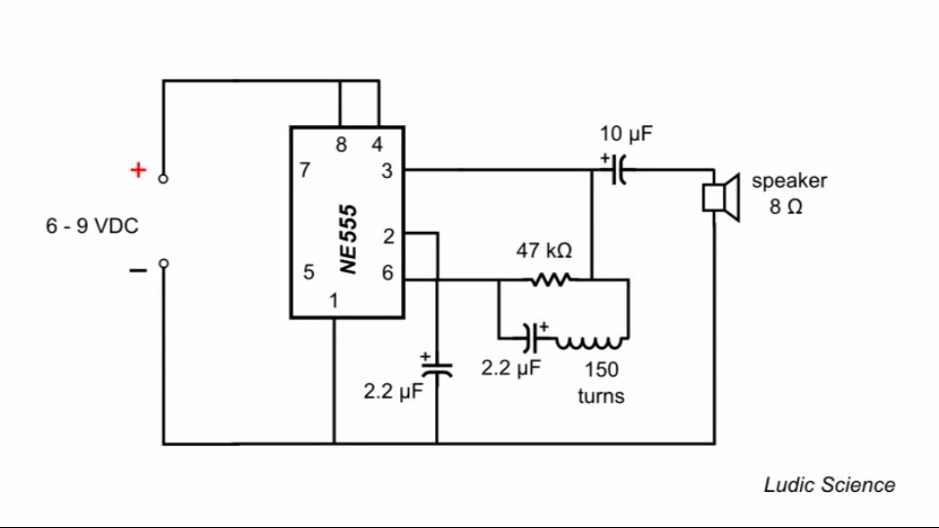

Slide 3
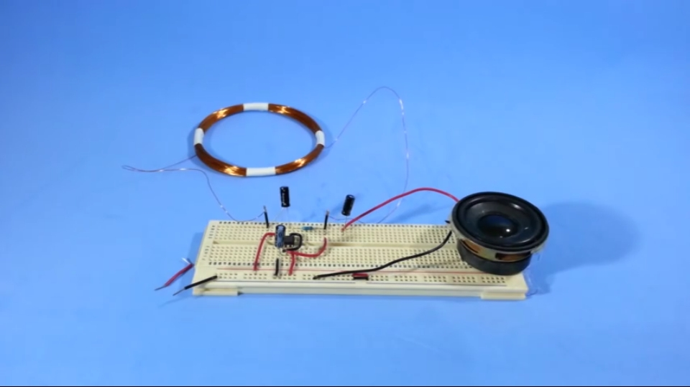

Slide 5
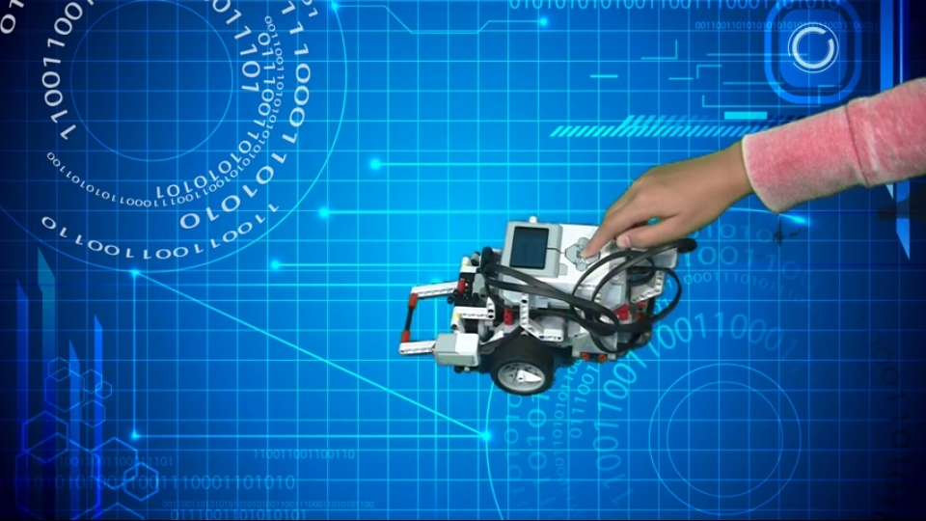

Slide 6
CAUSE DUE TO
TRAFFIC

Slide 7
Cities like India , New York, London, and Paris have all had to deal with thousands of cars running through their streets each day. Traffic congestion is a big problem for everyone within the city. The main reasons why traffic congestion occurs are more cars, poor road management, and poor practices on behalf of employers.

Slide 8
One of the main reasons why there’s more congestion is due to more cars on the road. The adult population is increasing and therefore more people want their own personal transport to get around with. As the number of cars increase the chance of congestion also increases. It’s why in smaller towns and villages congestion is almost unheard of.

Slide 9
This is coupled with a lack of proper infrastructure. Councils and national governments fail to act on the looming threat of heavy congestion until it happens. The city doesn’t expand along with an increasingly car reliant population. A single street with a lane on each side before might not suffice in ten years after the population has increased. Authorities often fail to convert this into a dual carriageway.

Slide 10
Alternate routes are also a problem. Cities have limited capacity to expand due to poor funding and planning restrictions preventing building on green belt spaces. Cities are forced to work with the routes they already have. If they can’t increase the number of lanes it leads to congestion.

Slide 11
Employers can also play a part in dealing with congestion. Congestion almost always happens when people are travelling to and from work. Traffic congestion has eased in recent years as a result of growing unemployment and the introduction of more flexible work hours.

Slide 12
By adhering to the traditional 9-5 routines, there’s a greater chance of congestion. Everyone has to travel to and from work at the same time each day.
A lack of public transport, or poor public transport options, will also cause problems. If there isn’t enough buses, trams, or local trains people are forced to take their cars to work. The ratio of passengers to vehicles decreases, whereas if they were able to take the bus people would feel less of a need to drive their cars.

Slide 13
In many places, commuters are forced away from public transport by the private companies which run them. Increasing fare prices, especially on the trains, make driving a car with its associated high fuel costs cheaper than public transport. By pushing people back to their cars again they only exasperate the congestion problem.

Slide 14
TRAFFIC JAM PROBLEM
SOLUTION

Slide 15
There are things that are tried and work aroud world mainly in Europe.
1.) Decrease amount of lanes. Why? No matter amount of lanes if there is congestion there always will be no matter 20lanes or 2. But 2lane roads have smaller capacity thus pollution would be smaller and saved space should be used for biking lanes ect.

Slide 17
2.) Destroy, ban use of some roads that can be used as “shortcuts”. If they were build mainly for cars(like big bridges with little sidewalks) turn them into buses only roads for example. Why? Again it’s mathematically proven that shortcuts even if they would take 0 time increase total travel time and IRL also cause additional trafic.

Slide 18
3.) Get rid of big ring roads and highways. It create only more traffic.
4.) Do not allow use of local roads by general traffic. By putting signs “only for residents/workers”, making them death end(cul de sac, that also increase value of area couse of decreased noise and better safety).

Slide 19
5.) Create “bus only” lanes/roads. Also or make buses go there where people are, slooowly or create bus rapid system(buses working like fast trams/trains) or preferably mix both of those.
6.) Discourage usage of private cars. For example by ussage of toll gates at enter of city centrum. Even if gate would cost like 10cents it’s just a thing that people see as huge annoyance( lost of tiny amount of money at toll gate annoy people more than standing in traffic jamm for few hours)

Slide 20
7.) Get rid of traffic lights. Mainly by using roudabouts. It’s not so much about traffic but people simply tend to drive safer when there is no lights and roundabout make eventual collision less deadly(lower speeds and better angle).
8.) If city is grid based get rid of it by turning some lanes into buses, residents only or large walkpaths. And making many of them death end/cul de sac.
If geting rid of grid is not a option. At least turn it into roadabout like system by making streets one way.

Slide 21
